Slide 1




www.pragati-security.com
Pragati Security and Intelligence Services

Slide 2



About Us
PSIS (Pragati Security and Intelligence Services), provides security solutions to Corporate’s, Industries and Institutions. We offer human resources management services which are essential to smooth functioning of any business house. We have emerged as a trusted leader across these business segments pan India. Our security solutions are adopted to your needs. We combine regionals reach with extensive local expertise in our branch offices, which promotes close and long-term relationships with our clients.
To discover our security solutions provided various segment. Please visit our local PSIS website and get more details. PSIS here to help make our country a safer place. We have experienced and retired defence personnel and we do this by combining expertise in on-site, mobile and remote guarding with electronic security and experience in fire and safety. Our track record in corporate risk management adds further expertise. PSIS to create security solutions that solve real-life problems.
Pragati Security and Intelligence Services

Slide 3


Our Mission
Our Mission
To be one of the most preferred security service providers in both national and international markets.
Paucek and Lage
Our Vision
Provide top notch service fueled with commitment, consistency and reliability).
Our Values
Paucek and Lage
Value people- | Business Excellence | Customer Oriented | Integrity |Transparency | Courage and Discipline.
Pragati Security and Intelligence Services

Slide 4

Our security solutions
Are Flexible and Adoptable to your needs
Serve across segments
Have a regional reach and approach.
Are backed by carefully selected personnel like ex- defence, fire & safety
Offer wide choice of on-site, mobile and remote guarding system
Pragati Security and Intelligence Services

Slide 5










Range of PSIS Services
Manned Security
Audit & Consultancy Solutions
Managed Security Services
PSO
Event Security
VIP Escorts
Security Training
Range of PSIS
Services
Risk Analysis
Site surveys/audits
Quality Control Audits
Background Verification & Manpower Services
Technology Solution
Access Control
CCTV installations &Monitoring
Fire and Safety MIS ( Management Information Systems )
Conducting thorough background checks ensures safe and reliable hiring decisions. It supports a flexible employment model that allows workers to explore diverse roles and schedules while maintaining the stability of predictable pay and comprehensive benefits.
Pragati Security and Intelligence Services

Slide 6


Why us?
PSIS is not just into Man Guarding, but a single desk for total security solutions. We are different as our focus is on stringent selection process and quality training.
Our team of professionals are able to customize the guarding duties to suit specific needs of the customer. We conduct on-site training and fire drills on a weekly and fortnightly basis respectively to all our guards and supervisors.
Pragati Security and Intelligence Services

Slide 7


P S I S - Security Training
We have standard training program and also have the flexibility to customize the modules to meet clients’ specific requirements, ensuring economy and effectiveness.
We specialize in providing training and consultation to our clients in the following areas:-
Security related training, development and consultancy
Risk management consultancy
Pragati Security and Intelligence Services

Slide 8

Operations Management
We have a well-defined organization structure and escalation matrix to ensure client focus. Incident Response Procedures include reporting to control room, rushing RRT’ (Rapid Response Team) STO the spot ( Security Through Obscurity), Operation manager on site evaluates, investigates and mitigates the issue with a preventive action plan.
Frequency defined multi-tier supervision
Peer vigilance and night checks
Quality audit, customer feedback and performance review are some of the inbuilt processes of our operation management system.
Pragati Security and Intelligence Services

Slide 9



Value Added Services
Rapid Response Team in case of emergencies
Every SO/Site in charge is provided with a mobile phone
A dedicated operation manager
Pragati Security and Intelligence Services

Slide 10

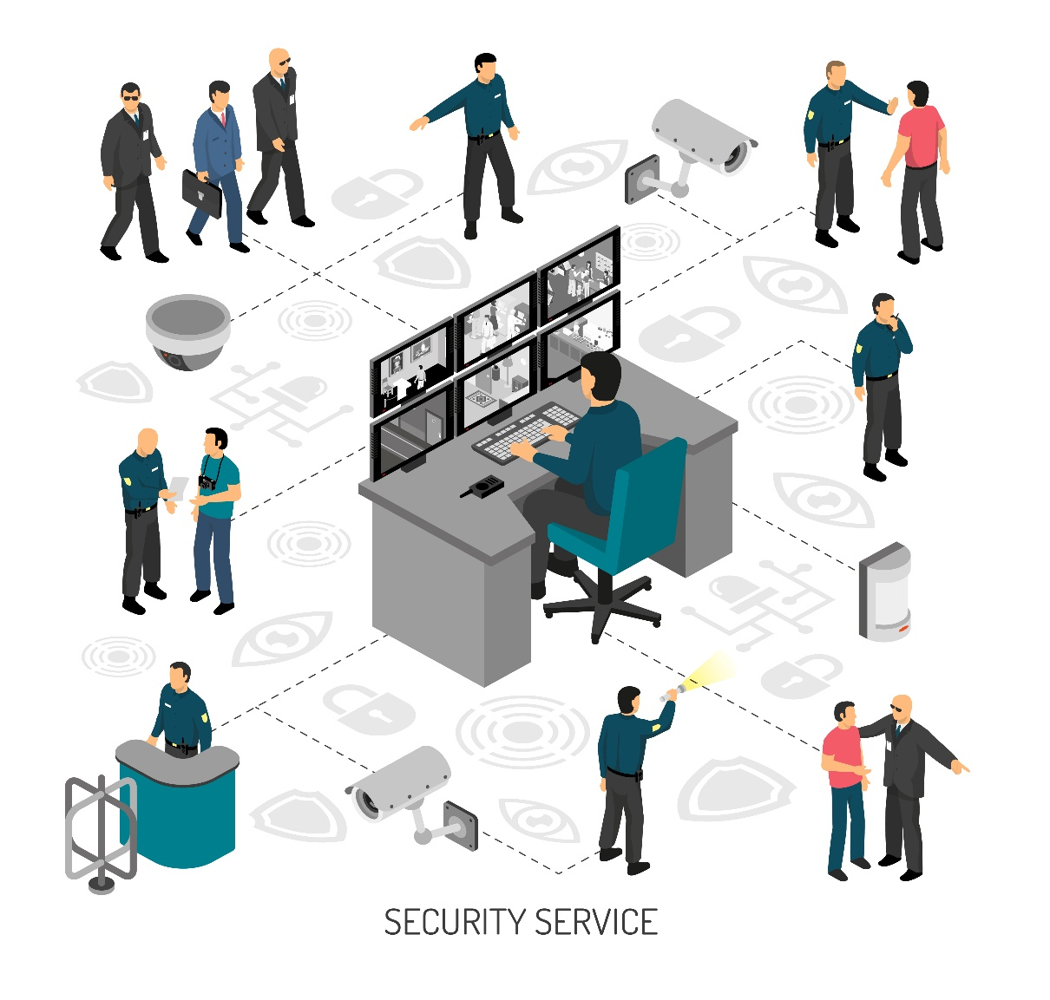














P S I S Site Taking Up Procedure
FORMULATING SECURITY PLAN / DESIGN
SUBMISSION OF SURVEY REPORT / RECOMMENDATIONS
SITE SURVEY
REGULAR REVIEW AND UPGRADATION PLAN
DEPLOYMENT
SIGNING UP POST & SITE INSTRUCTIONS/SLA / AGREEMENT
Pragati Security and Intelligence Services

Slide 11

PSIS Process
We keep our people happy
Quarterly rewards on exceptional duty.
Management team support when required.
100% statutory compliance company.
Invoices submitted to the client are
supported by all compliance documents.
Copy of documents pertaining to
deployed guards are shared with
client for reference Guard Force is provided with basic
security instruction manual
Pragati Security and Intelligence Services

Slide 12

Technology Solution
Command & Control Services
This service helps customers to integrate all existing or proposed physical security controls from various vendors into a single application. The system supports customer’s ground staff by enforcing automated rules from various systems.
Access Control Services
This service helps customers to build, integrate physical access control infrastructure. It helps customers to integrate all physical doors, entry/exit points, and other critical points access onto a single card.
Video Surveillance Services
This service helps customers to build intelligent video surveillance system infrastructure. The system also helps customers to focus on real-time incidents using artificial intelligence and enable anytime surveillance. This service helps customers to build, integrate physical access control infrastructure. It helps customer to integrate all physical doors, entry/exit points, and other critical points access.
Pragati Security and Intelligence Services

Slide 13


Security Audits
Physical Security Audit
Man Guarding
Security Systems
Guards Grooming & Training Guards Knowledge ( Post & Site ) Security Policy Knowledge
CCTV Access Control, Fire Systems, Intruders & BMS System
Compliances Operational Documents
Pragati Security and Intelligence Services

Slide 14

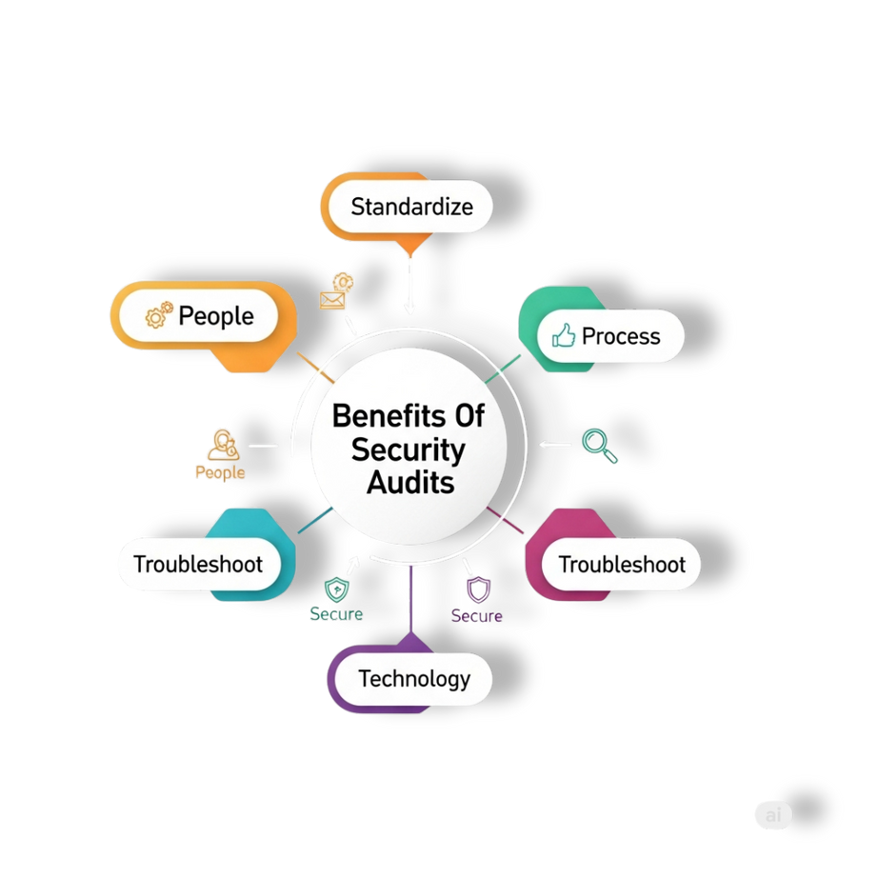

Benefits Of Security Audits
It genuinely tests the efficiency of your security defense on a regular basis.
Duty Officers in our security team remain alert and focused at all times.
You are able to identify the potential weakness in the security operation and take appropriate preemptive actions.
It forms part of your organization’s wider audit remit for insurance and corporate governance purposes.
It shows senior management that you are being proactive – rather than reactive– and that you have taken every measure to safeguard the company’s premises.
Pragati Security and Intelligence Services

Slide 15

“ 7 ” Reason to Choose
PSIS is not just into Man Guarding, but a ‘single desk’ for total security solutions. We are different due to our focus on stringent selection process and quality training. Our team of professionals are able to customize the guarding duties to suit specific needs of the Costumes.
2. We conduct on-site training and fire drills for all our guards and supervisors on a weekly and fortnightly basis respectively.
3.Cost Effective
We assist in various ways to save additional overheads and crop hidden expenses involved in Food Service. These have a healthy impact on the P&L of our clients.
.
4.Human Resource Policy
We adopt best practices and periodically train our staff on core skills set and latest technology
5.Operational Excellence
We deploy adequately skilled workforce required to provide customer delight and achieve operational excellence.
6. Statutory Compliance As a group we are 100% statutory compliant.
7. Business Ethics and Code of Conduct
We ensure that everyone in the company is clear about the mission, values and guiding principles of the company. It provides employees a framework of rules that exist from a regulatory and law-enforcement standpoint.
Pragati Security and Intelligence Services

Slide 16





Clients
Pragati Security and Intelligence Services

Slide 17


Contact us
Pragati Security and Intelligence Services Pvt. Ltd.
Backside of Gourishankar English Meduim School, Plot No - 239, Rudra Vihar, Sishupal Garh, Dhauli. Bhubaneshwar, Khordha, Odisha - 751002.
+91 99375 75915 , +91 89176 29368
www.pragati-security.com
Pragati Security and Intelligence Services

Slide 18



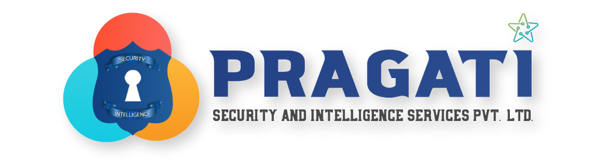

Thank you

